Slide 1
Fully Qualified Domains, Fully Qualified Table Names, and Taxonomies
Kyrilous Nasr, Jacelin Gomez, Hali Ding, Fakriha Kamal, Bikash Shrestha, Ahsan, Dominik Kasza

Slide 2
Table of contents
01
02
03
Fully Qualified Domains
Fully Qualified Table Names
Taxonomies

Slide 3

01
Fully Qualified Domain

Slide 4
What is a Domain?
A domain is a data type with optional constraints. They are essentially just ‘global’ constraints. For example, if multiple tables store phone numbers, instead of writing the same validation rule repeatedly for each table, we can define a PhoneNumber domain once, give it the constraint we need phone numbers to have, and then reuse it wherever a phone number is needed. This promotes consistency and avoids errors.
You can think of it like using #define in C++, both Domains and #define let us create a rule or definition in one place, and reuse it everywhere else. If the rule changes, we update it once where we defined it, instead of updating multiple tables or code sections.

Slide 5
Fully Qualified Domains
What do we mean by FULLY QUALIFIED domain?
Example:
A fully qualified domain is simply a domain whose name is unique, clearly understood, and includes the taxonomy hierarchy that it belongs to. This makes the domain name clear and prevents confusion since different parts of the organization may use similar domain names.
Not qualified domain: Email
Qualified domains: Nissan.Employees.Email Nissan.Customers.Email
Here you can see that Nissan.Employees.Email includes the name of the database(Nissan), the name of the table(Employees), followed by the element we want to set the constraint on(Email). We might want to enforce two different sets of rules depending on if the email is a customer email or an employee email, hence simply using the domain ‘Email’ would not be descriptive enough.

Slide 6
Fully Qualified Domains
What do we gain from using fully qualified domains?
Ensures consistent data formatting across multiple tables and systems.
Allows shared validation rules to be defined once and reused wherever needed.
Helps different teams interpret the data in the same way.
Allows for easier database growth. New tables and systems can plug into existing domains instead of having to reinvent data rules.

Slide 7
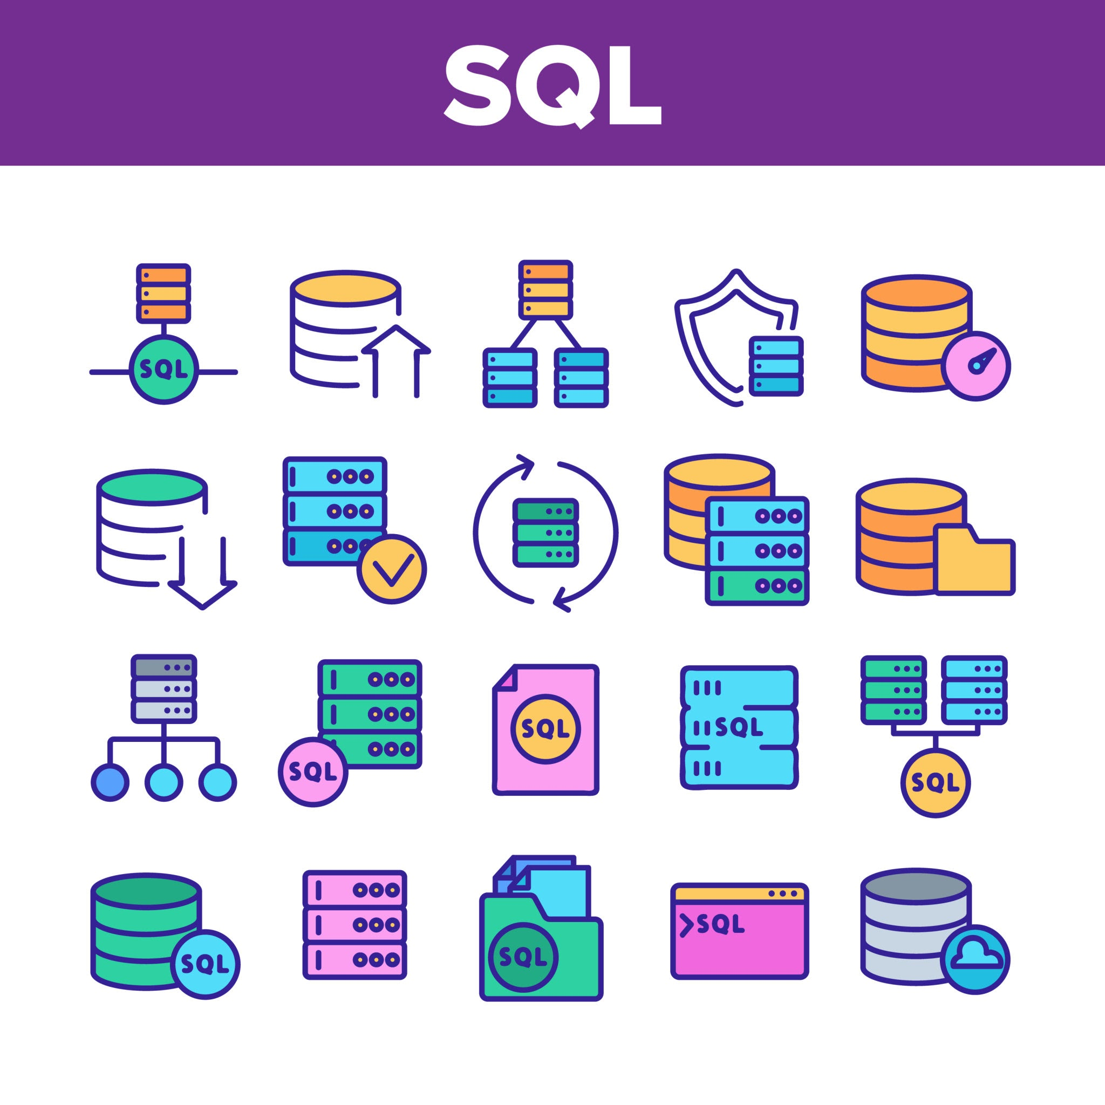
02
Fully Qualified Table Names (FQTN)

Slide 8
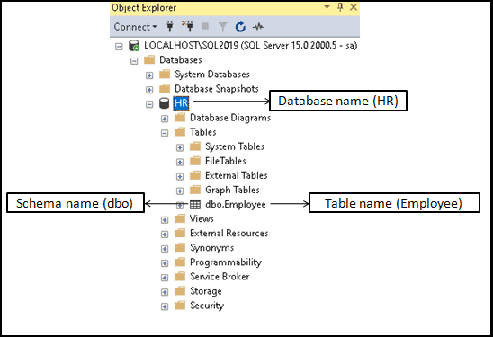
Fully Qualified TABLE NAMES
What is a fully qualified table name?
A fully qualified table name consists of three parts. The database name which the schema belongs to, the schema name which the table belongs to, and the actual table name.
Instead of simply creating an ‘Employee’ table, we give it a qualified name. Since we have different departments within our organization (HR, Sales, CustomerService, etc..), we need to make sure we separate them into their corresponding categories. This is why we would name our HR Employees table as ‘HR.dbo.Employee’. This employee table will be different than Sales.dbo.Employee.

Slide 9
Why do we need Fully Qualified Table Names?
In practice, many systems contain multiple items that may be different with the same name. For example, there could be two ‘Employees’ tables:
One in the Sales database
One in the Admin database
Just saying ‘Employees’ is not enough, we need the full reference now. Such as:
SalesDB.dbo.Employees
AdminDB.dbo.Employees
We are essentially creating parent and child hierarchies, where each level can help us identify more clearly where this element we are looking at lives. Similar to the fully qualified domain, where we are specific about what the data means, fully qualified table names require us to be very specific about where the data is located.

Slide 10
Fully Qualified TABLE NAMES (FQTN)
What do we gain from using FQTN?
Precision
3. Reliability
5. Scalability
Ensures we always reference the exact table we intent, even if multiple tables share the same name across databases.
Enables reliable joining of tables.
Allows for smooth scaling, as organizations add new databases, FQTNs maintain consistency and prevent confusion.
2. Clarity
4. Transparency
Queries become easier to read and understand because the source of the data is always explicitly stated.
Makes it easier for users to understand what data they are looking at, and what they can query.

Slide 11
CREATE TYPE vs CREATE DOMAIN
Both CREATE TYPE and CREATE DOMAIN are used for creating user defined data types, but they differ slightly when it comes to functionality.
CREATE DOMAIN:
Used to define a new data type with constraints.
Ex: CREATE DOMAIN PhoneNumber AS INTEGER
CHECK (LEN(PhoneNumber) = 10)
CREATE TYPE:
Used to define a new data type that consists of attributes. (Just like a class in OOP)
Ex: CREATE TYPE Employee AS (
name VARCHAR(100)
emp_id CHAR(10)
(etc…)
)
For CREATE TYPE:
“Checking” occurs at the table level when we are querying the table, we can filter for specific data by setting constraints using the WHERE clause.

Slide 12

03
Taxonomies

Slide 13
Taxonomies
What are Data Taxonomies?
A data taxonomy is a way of organizing and classifying data. It involves creating a hierarchy of categories along with their subcategories that can be used to organize the data consistently. As database systems grow, they can become extremely difficult to work with, some users may not even know what data is available, however with building a data taxonomy, these issues are fixed for us.

Slide 14
Taxonomies
Real World Example:
Example:
What This Means:
Think of Amazon’s categories:
Electronics
└── Computers
└── Laptops
└── Gaming Laptops
CREATE TABLE Categories (
CategoryID INT PRIMARY KEY,
CategoryName VARCHAR(100),
ParentCategoryID INT NULL
);
Then you insert data:
INSERT INTO Categories VALUES
(1, 'Electronics', NULL),
(2, 'Computers', 1),
(3, 'Laptops', 2),
(4, 'Gaming Laptops', 3);
Electronics is the parent of Computers
Computers is parent of Laptops
Laptops is parent of Gaming Laptops

Slide 15
Taxonomies
Now You Can Query:
SELECT * FROM Categories WHERE ParentCategoryID = 2;
This shows Laptops, because it’s under Computers.
Think of it like folders in your computer:
“Electronics” is the main folder → “Computers” → “Laptops”.
That’s a taxonomy — a hierarchy of categories.

Slide 16
Resources
https://hightouch.com/blog/what-is-data-taxonomy
https://www.geeksforgeeks.org/sql/sql-create-domain/
https://www.tektutorialshub.com/sql-server/fully-qualified-table-names-in-sql-server/#fully-qualified-table-name
https://hightouch.com/blog/what-is-data-taxonomy
https://learn.microsoft.com/en-us/sql/t-sql/statements/create-type-transact-sql?view=sql-server-ver17

